Slide 1

Our Platform for Dynamic EV Battery Rentals and Real-Time Performance Monitoring
Our platform provides a seamless solution for electric vehicle (EV) owners, enabling dynamic battery rentals and real-time performance monitoring across all deployed devices.

Slide 2
Enabling Immediate Decision-Making with Lightweight AI Models on Vehicles
Local AI Models
Rapid Response
Each vehicle hosts lightweight AI models that can make immediate decisions based on local usage patterns, ensuring offline reliability.
Our distributed AI techniques allow vehicles to rapidly adapt to changing conditions, optimizing performance and reducing range anxiety.

Slide 3




Preserving User Privacy through Distributed AI Training
Private Data Storage
Aggregated Model Updates
Raw user data is kept on the device, ensuring privacy and security.
Only model updates, not sensitive data, are shared with the cloud for continuous improvement.
Collaborative Learning
Vehicles learn from each other's experiences while preserving individual privacy.

Slide 4






Aggregating Model Updates to the Cloud for Continuous Improvement
Model Updates
Performance improvements are shared with the cloud, informing the next generation of models.
Vehicle AI Models
Vehicles continuously refine their local AI models based on real-world usage.
Optimized Models
The cloud distributes the updated models back to vehicles, enhancing overall performance.

Slide 5

Optimizing Battery Utilization and Reducing Range Anxiety
Dynamic Battery Rentals
Our platform enables users to rent additional battery capacity on-demand, ensuring they always have the range they need.
Predictive Analytics
Real-time performance data and AI-powered analytics help vehicles anticipate energy needs and optimize battery usage.
Adaptive Charging
Intelligent charging schedules and vehicle-to-grid integration further enhance battery efficiency and resilience.

Slide 6
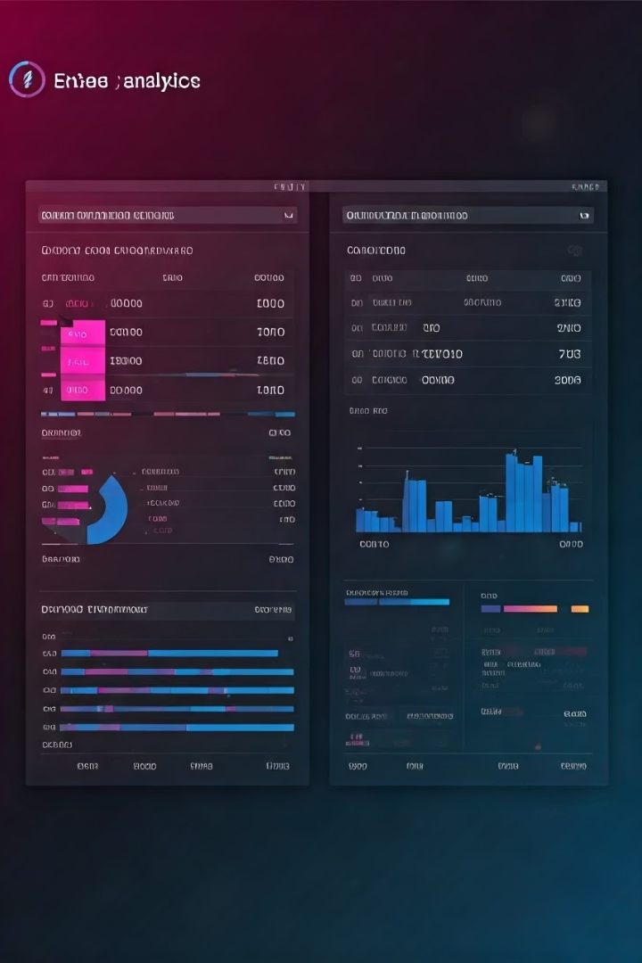



Providing Actionable Insights to Fleet Operators and Vehicle Owners
Performance Monitoring
Comprehensive dashboards provide real-time insights into battery health, energy consumption, and more.
Predictive Maintenance
AI-powered analytics help identify potential issues and recommend proactive maintenance actions.
Cost Optimization
Our platform enables data-driven decisions to reduce operating costs and improve fleet efficiency.

Slide 7

Integrating with Existing EV Charging Infrastructure
1
Seamless Connectivity
2
Intelligent Scheduling
Our platform seamlessly integrates with various EV charging providers, allowing users to access a wide network of charging stations.
AI-powered scheduling algorithms optimize charging times to reduce costs and avoid peak demand periods.
3
Vehicle-to-Grid Integration
Bidirectional charging capabilities enable vehicles to participate in grid balancing and energy optimization programs.

Slide 8






The Future of Sustainable and Intelligent Mobility
Autonomous Driving
Seamless integration with self-driving technologies for a fully-autonomous mobility experience.
Sustainability
Reduced emissions and energy-efficient operations supporting a greener future.
Smart Cities
Synergies with urban infrastructure and intelligent transportation systems for a connected mobility ecosystem.
Our platform paves the way for a future of sustainable, intelligent, and autonomous mobility, transforming the way people and goods move within and between cities.

